Slide 1

Capstone Presentation TARP, LLC Jamie Anderson, Jon Harris, Vincent Ji and Joe Lu

Slide 2
Agenda
About Us
P2P Lending Industry
How We can Help Investors
Future Work

Slide 3

About Us (TARP, LLC)
TARP, LLC is an investment advisory firm, powered by data science
Our goals:
Help investors understand opportunities in P2P lending
Invest their capital in more systematic manner, using data visualizations and machine learning models

Slide 4

Explosive Growth of P2P Lending
Rise of P2P lending fueled by increasingly powerful computers, plethora of big data sets, and banks lending less than pre-2008
For instance, now fin-techs provide 50% of unsecured personal loans in 2020 (compared to 20% in just 2015)

Slide 5
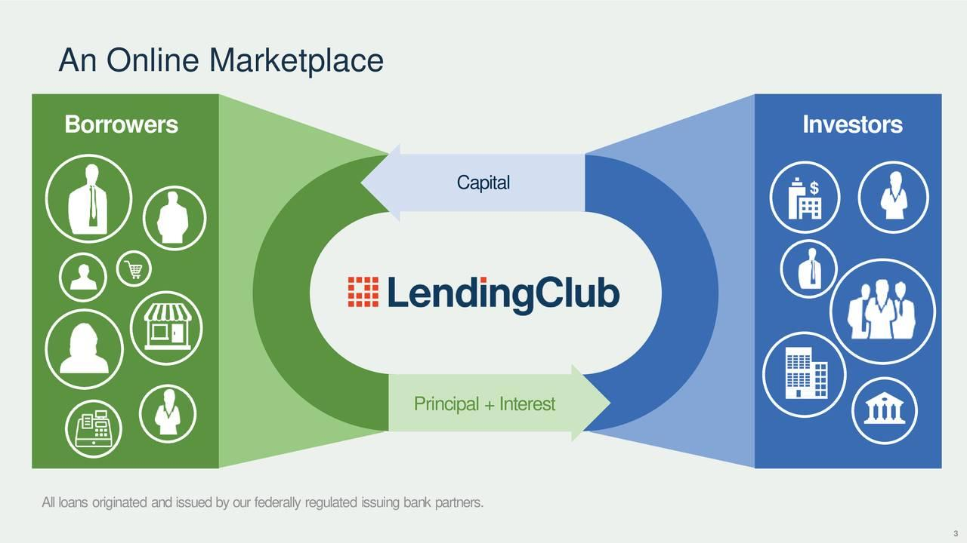
P2P matches borrowers and lenders online
Benefits to borrowers:
Quick funding
Lower Interest rate
Benefits to investors:
Access to consumer credit
Loan Diversification

Slide 6
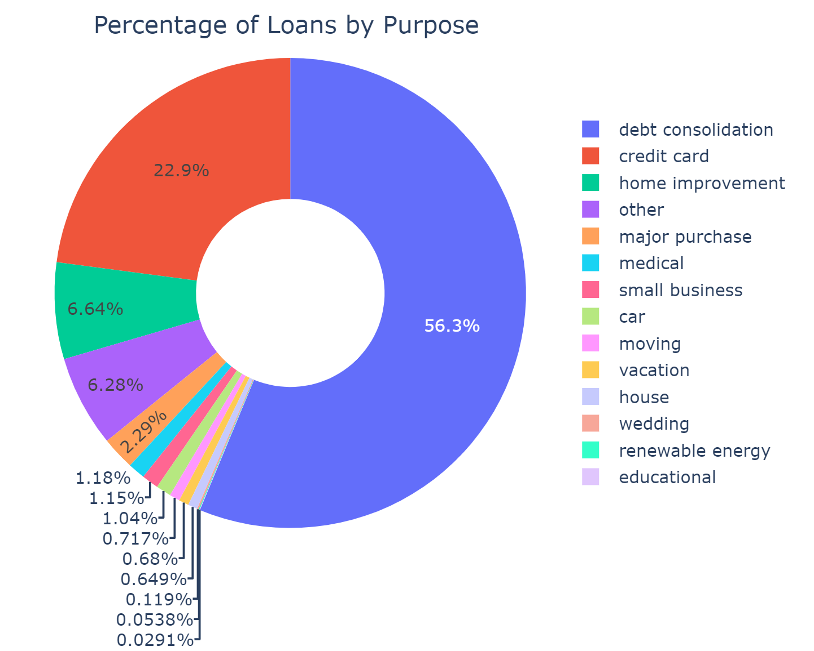
How does LendingClub® Fit In?
LendingClub® determines if borrower is creditworthy based on
Credit score
Payment history
Requested loan size
Debt-to-income ratio
…
To reduce credit risk to investors, LendingClub® approves only ~10% of loan applications and assigns interest rates proportionally to credit risk

Slide 7
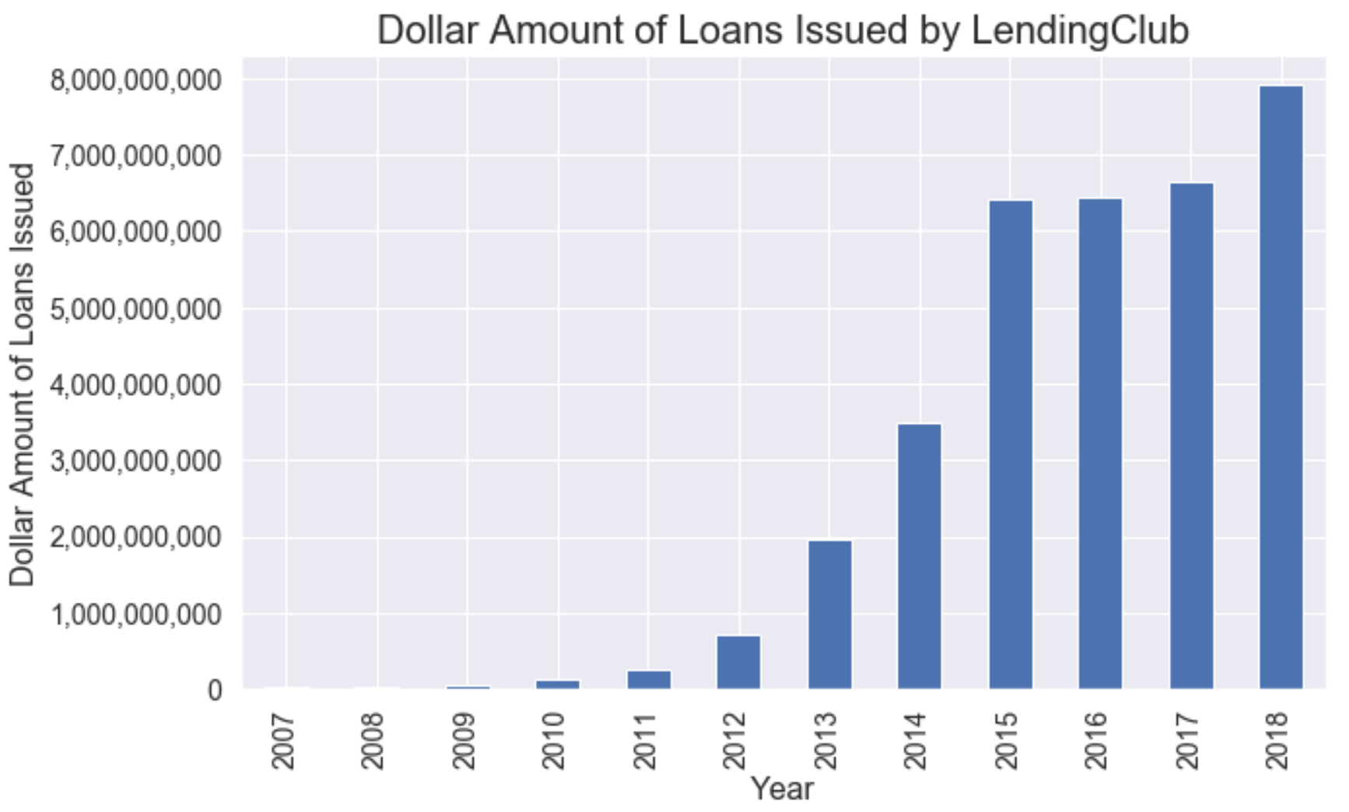
Explosive Growth of Lending Club
LendingClub® received a $125 million investment from Google.
Notes:
Presenter mentions that there are a couple hundred of loans in 2007. 2013 is the the inflection point when there were ~130,000 loans. In 2018, the number increased to ~500,000 loans

Slide 8
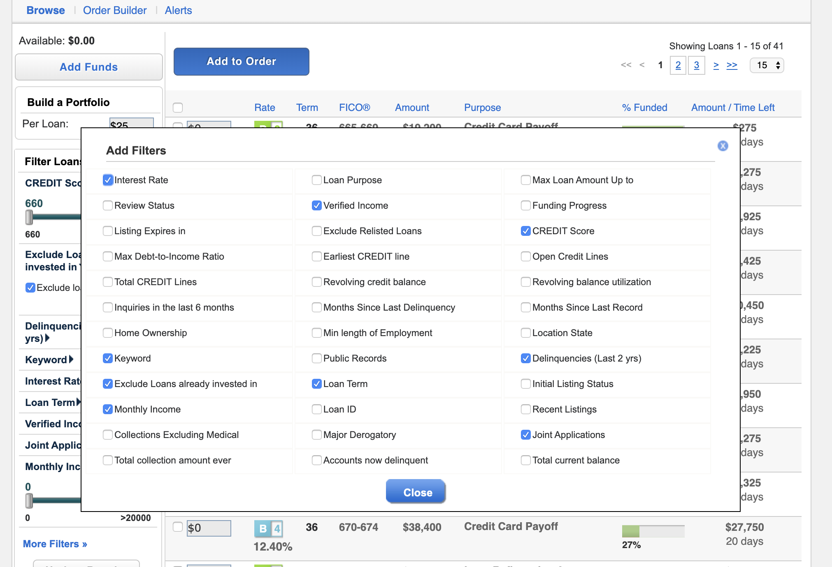
Choosing a Loan as an Investor
Features to select from:
Interest rate of loan
Grade of loan
Term of loan
Borrower’s credit score
Borrower’s debt-to-income
…
Total 29 factors to choose from

Slide 9
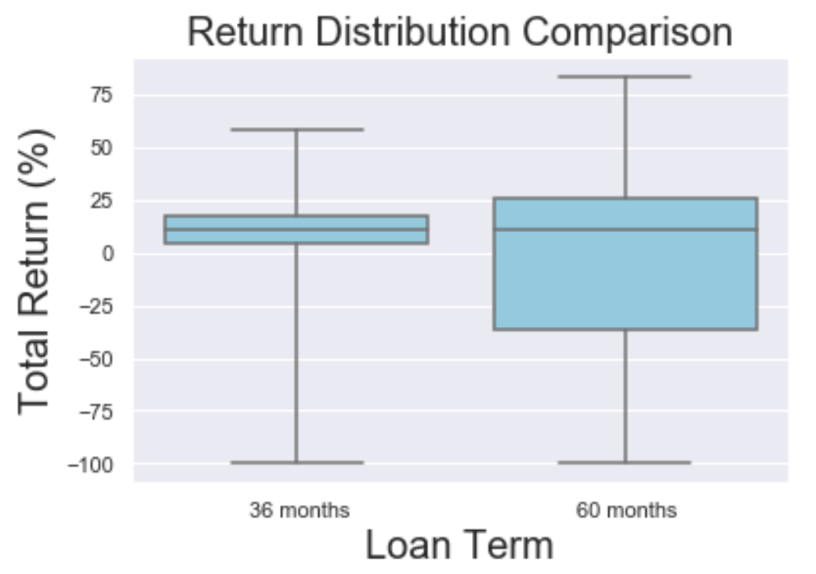
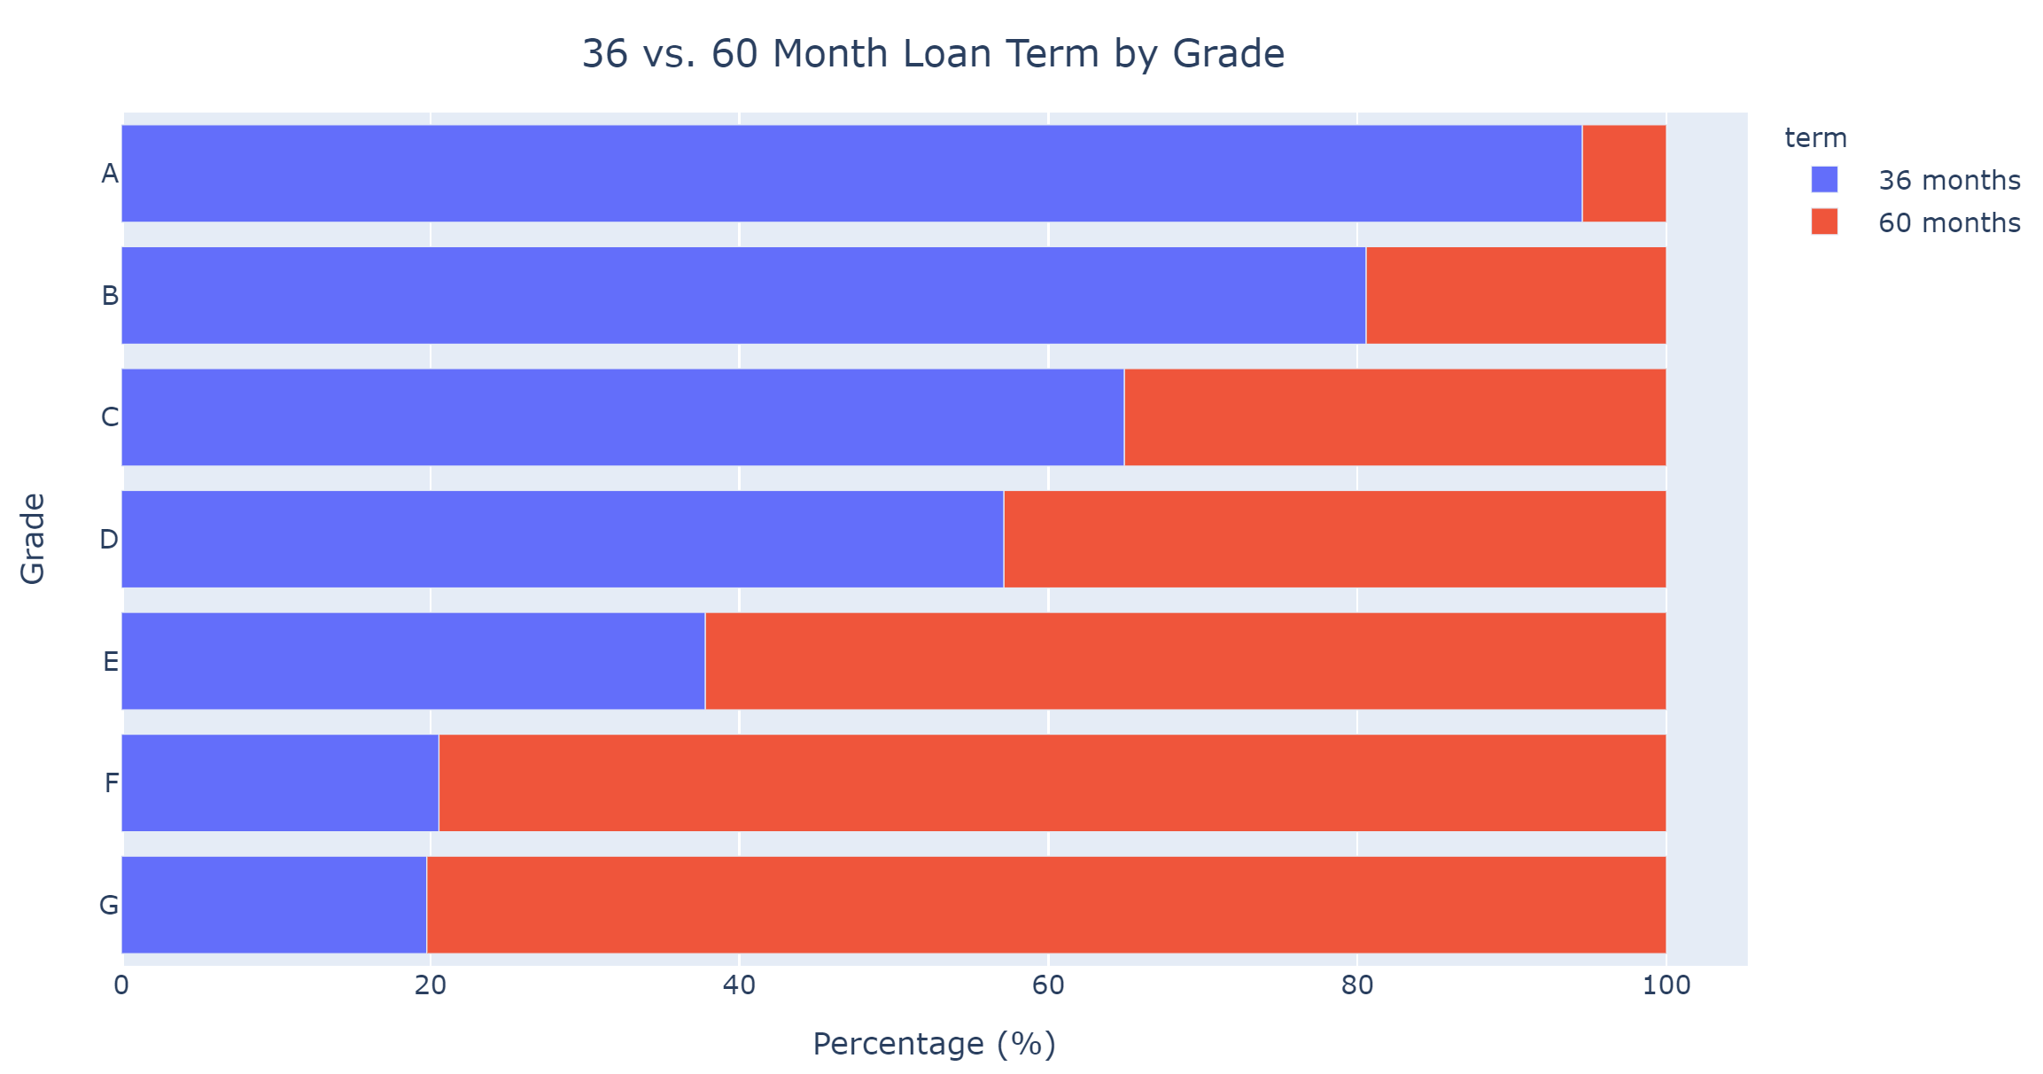
Feature Interdependency

Slide 10
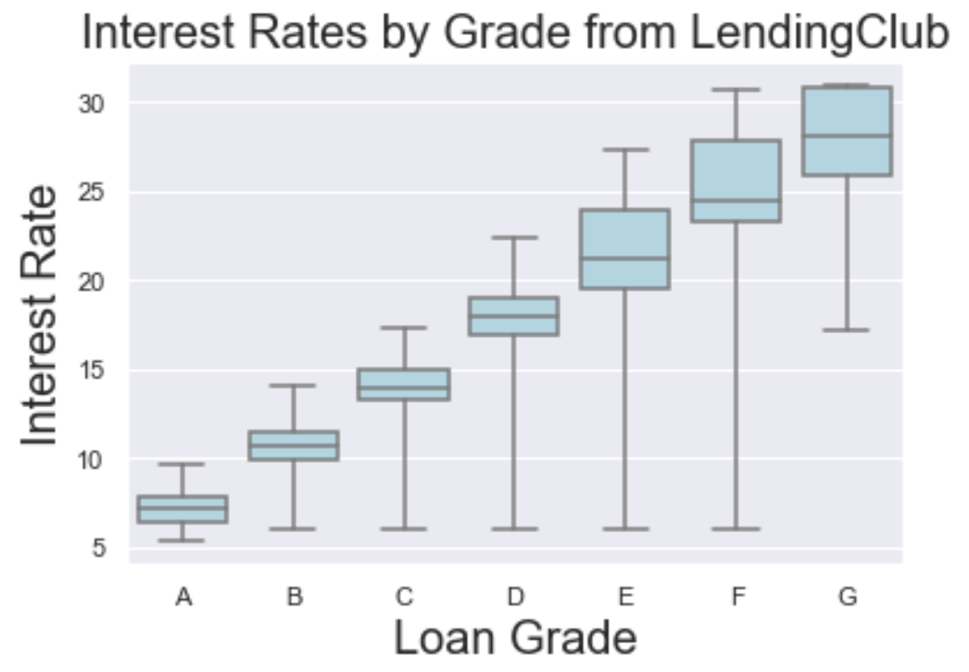
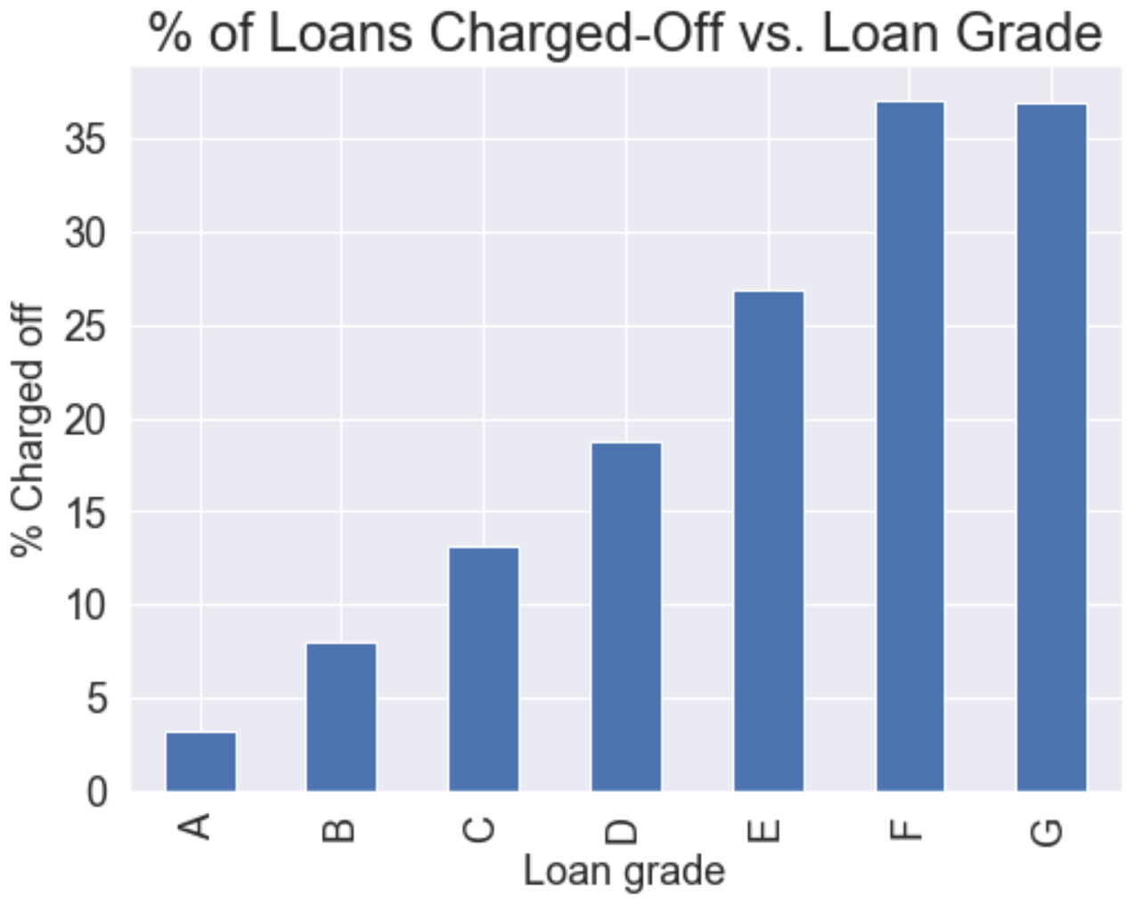
Feature Interdependency

Slide 11
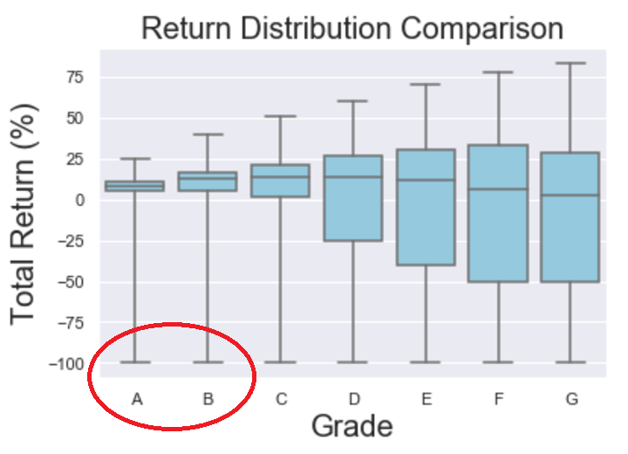
High Grade Does not Guarantee Great Return

Slide 12

How to Avoid Huge Losses?
Even grade A and B tranches contain some loans with -100% Return On Investment or ROI (loss of all invested principal)
How can we avoid this situation?
“Don’t put all of your eggs in the same basket”
Toss 1 coin: 50% chance of tails
Toss 10 coins: 0.1% chance of all tails

Slide 13
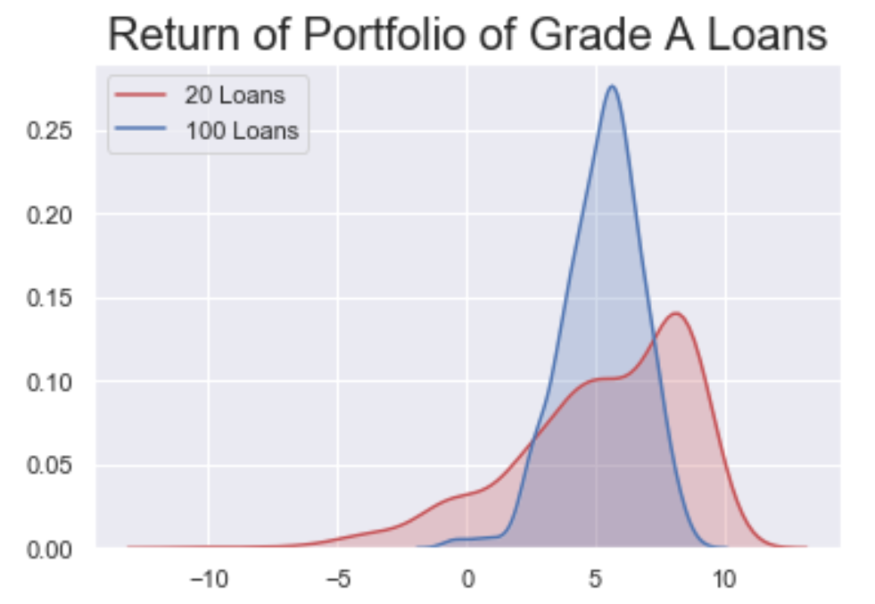
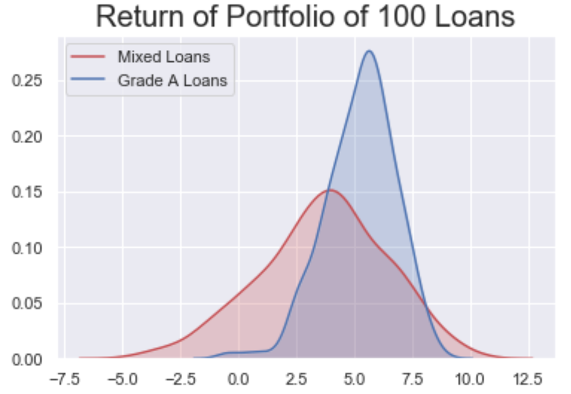
Power of Diversification
Return on Investment (%)
Return on Investment (%)
How can we use data science and ML to improve return on investment?

Slide 14

The Need for ML Classification
Goal is risk aversion, i.e., to avoid high-risk loans
Need to classify loans
Low-risk: ROI > -20% (83.8%)
High-risk: ROI < -20% (16.2%)
Classification algorithms trained
Logistic regression
XGBoost

Slide 15
Approach to Deal with Imbalanced Dataset
Goal of classifier is to avoid false positives
i.e., misclassifying high-risk loans as low-risk
False negatives less harmful
Approach:
Brute force methods available: down-sampling majority class or up-sampling minority class
Classifier algorithms parameter to handle imbalance:
Logistics (class_weight) and XGBoost (scale_pos_weight)
AUC Precision-Recall to evaluate model
Accuracy (ROC AUC) inappropriate for imbalanced data
E.g., if we guess all loans are good, already have 83.8% accuracy (default false discovery rate is 16.2%)
Model | False Discovery Rate (Imbalanced) | False Discovery Rate (Balanced)
Logistic Regression | 16.2% (null model) | 9.3%
XGboost | 15.9% | 9.2%

Slide 16
Classification Results
 | Logistic Regression | XGBoost
% of Low-risk loans | 83.8% | 83.8%
Precision | 90.7% | 90.8%
False Discovery Rate | 9.3% | 9.2%
How can we use these classifiers improve return on investment?

Slide 17
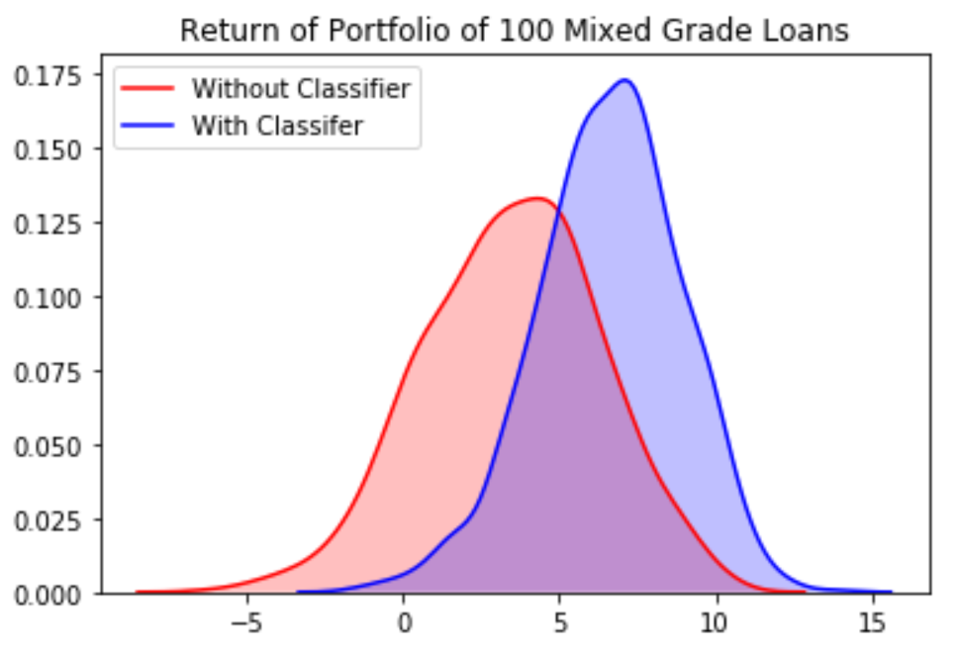
Let’s revisit our portfolio of 100 loans (25 grade A, B, C and D loans)
Return on Investment (%)

Slide 18
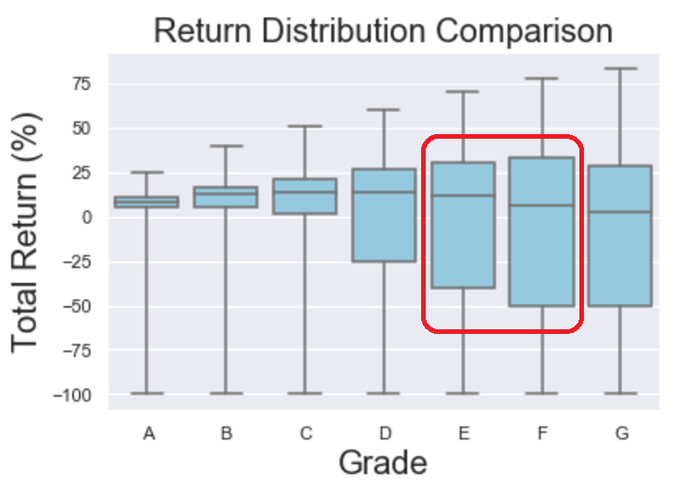
How About High-risk Loans?
Given the wide distribution in grade E and grade F loans, our classifier should do well in these categories.

Slide 19
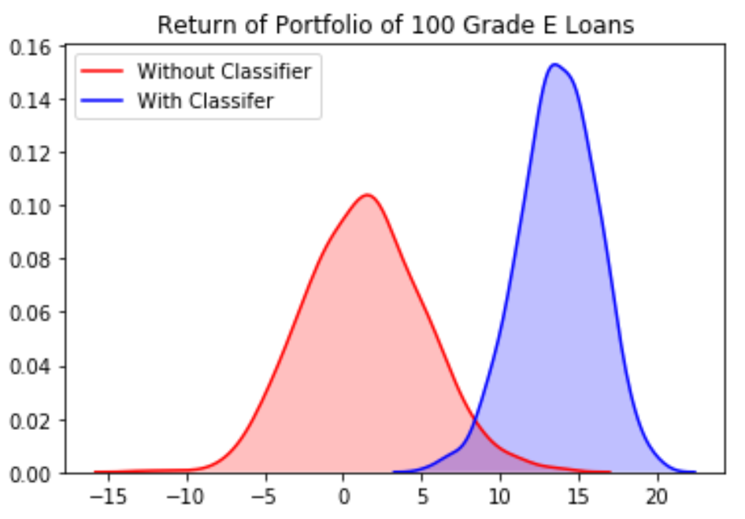
The Performance on Grade E is even better.
Return on Investment (%)

Slide 20
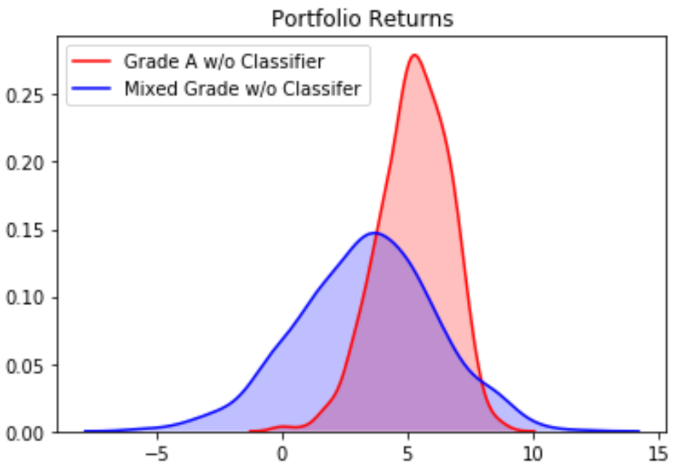
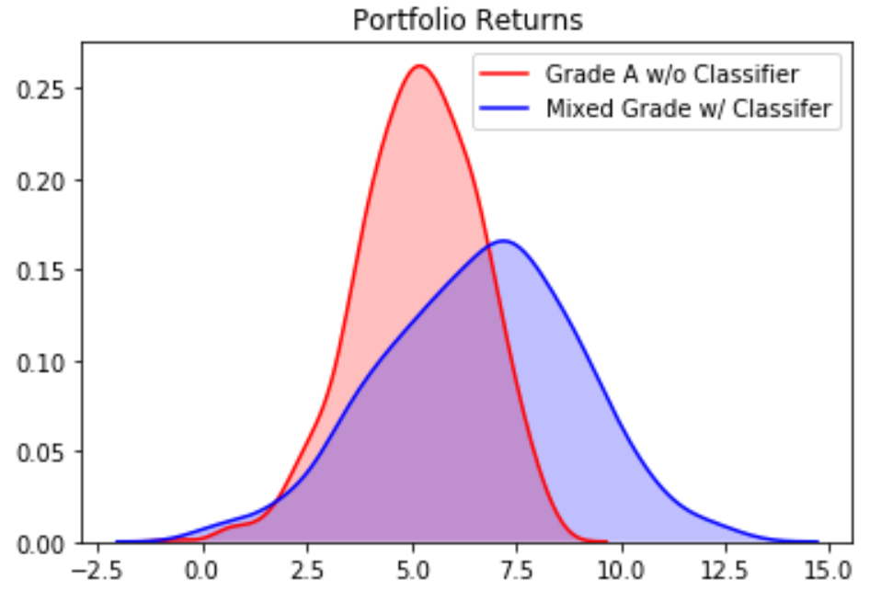
Classifier Improved Mixed Grade Significantly
Return on Investment (%)
Return on Investment (%)

Slide 21

Future Work
Back-history testing to analyze robustness of the model over time
Expand the model to incorporate rest of the 150 features
Survival Analysis

Slide 22

About the Authors
If you would like to learn more about the authors, please check out our LinkedIn pages
Jamie Anderson: in/james-anderson-b3519711b/
Jon Harris: in/jonharriseit/
Vincent Ji: in/vincent-ji-5880a213/
Joe Lu: in/joezlu/

Slide 23
Appendix

Slide 24
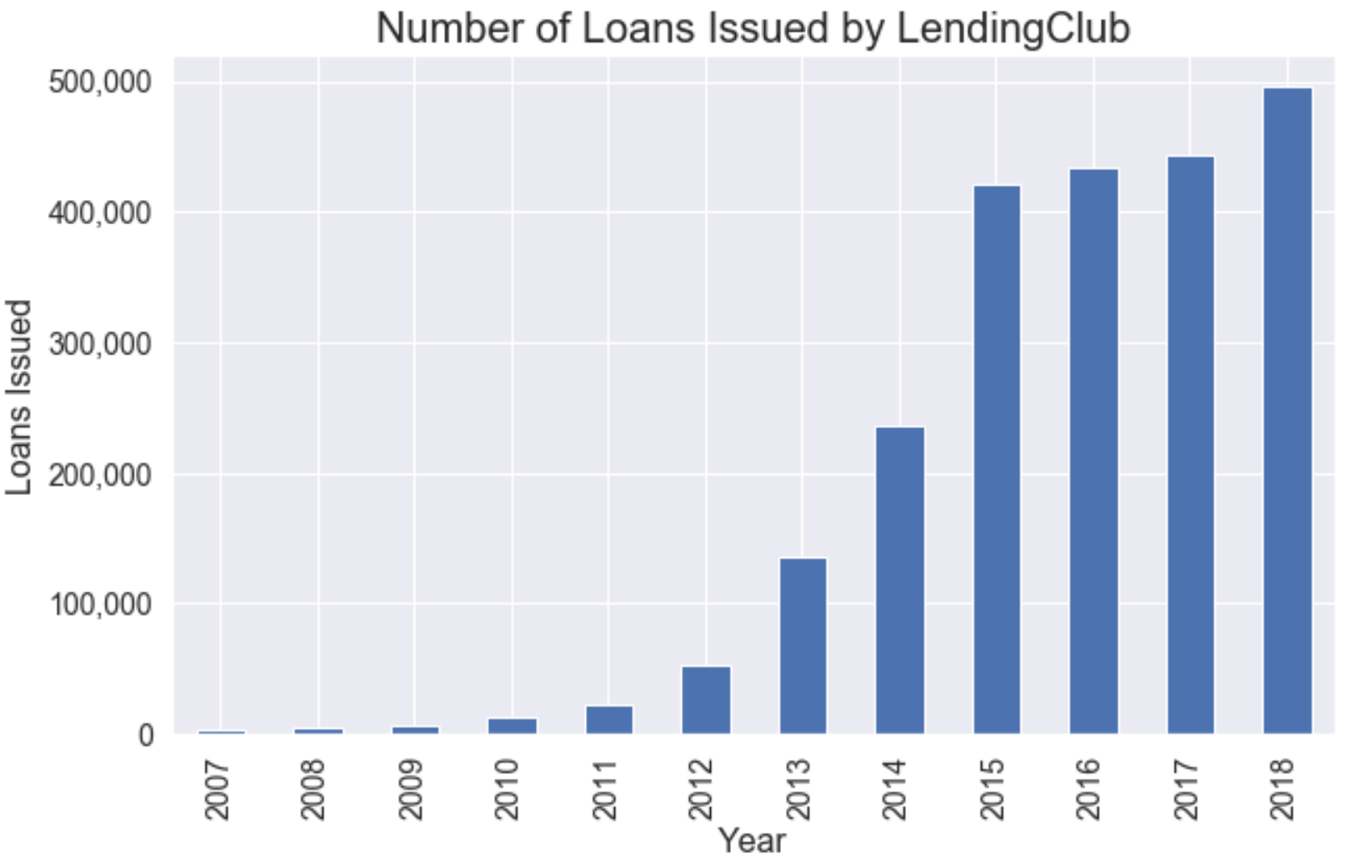
Explosive Growth of P2P Lending

Slide 25

Choosing a Loan as an Investor

Slide 26
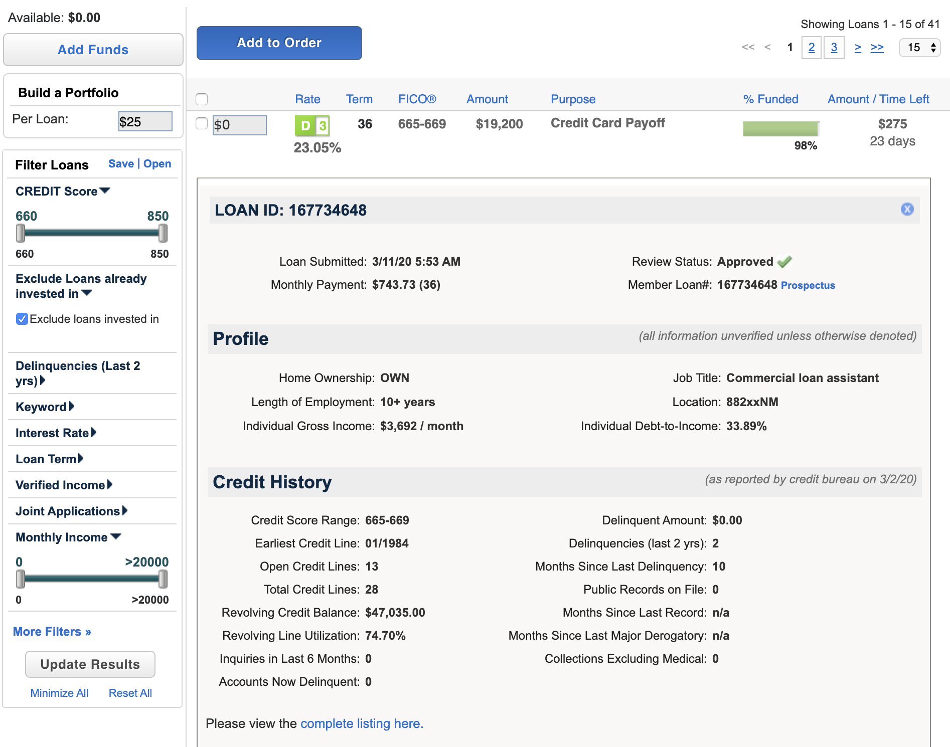
Choosing a Loan as an Investor

Slide 27
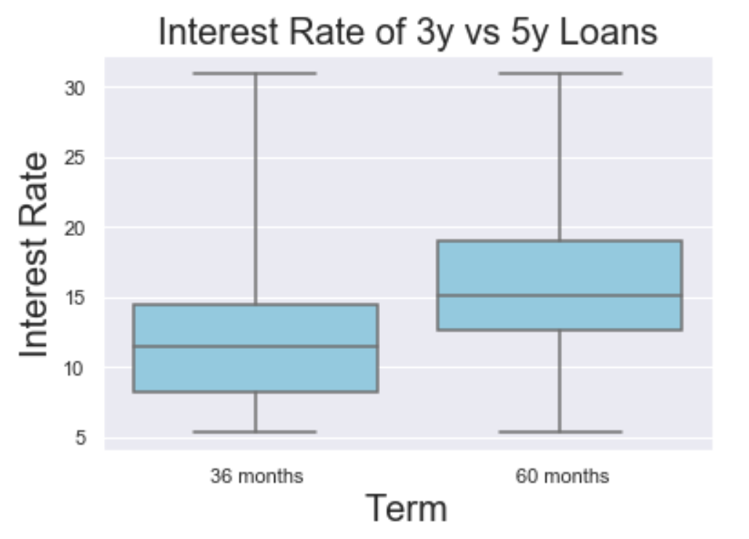
Loan Criterion: Term

Slide 28
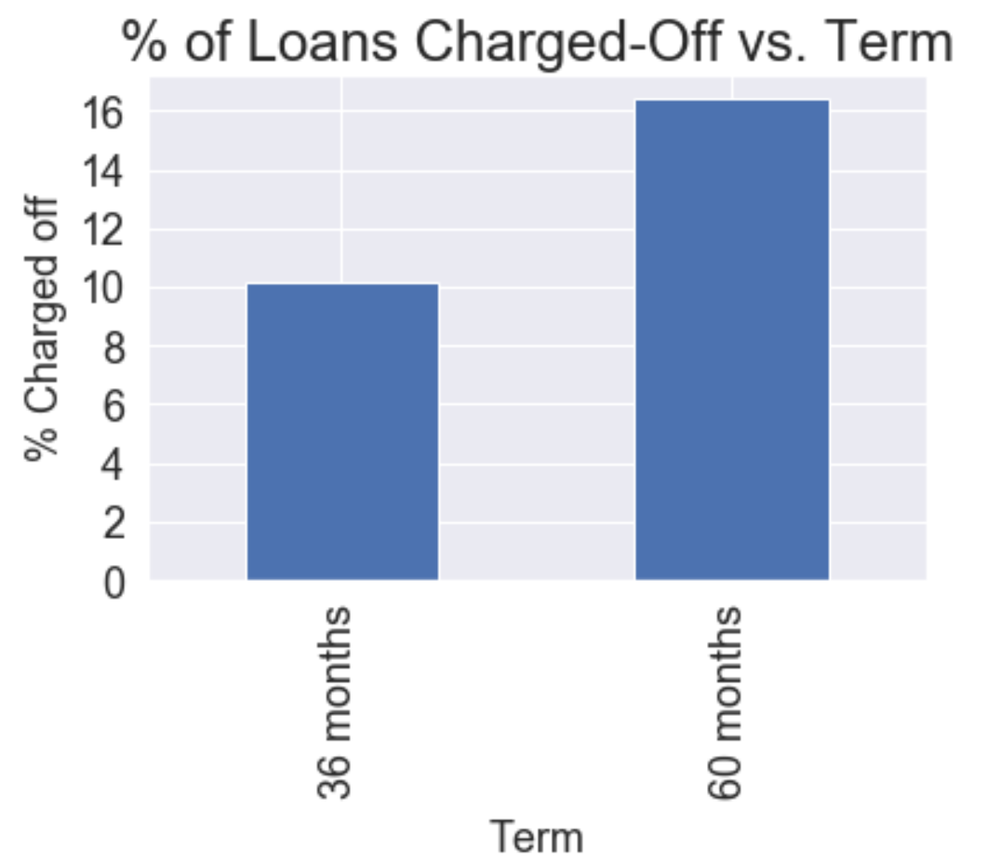
Loan Criterion: Term

Slide 29
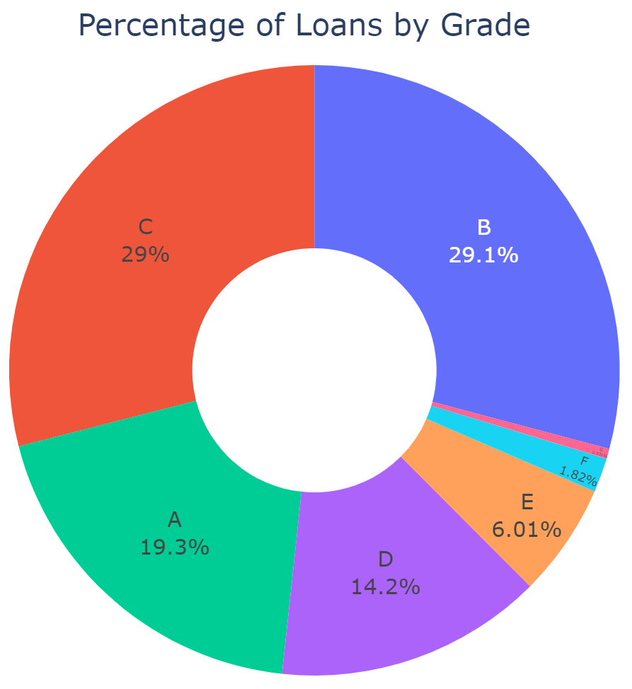
Loan Criterion: Grade

Slide 30
Classifier Selection
Decision Tree algorithms or CART (Classification and Regression Trees) are a very useful supervised learning method
High-accuracy, stability and interpretability
Can handle non-linear relationships
Very compatible with ensemble learning methods
Ensemble learning methods: Use multiple learning algorithms to improve predictive power

Slide 31
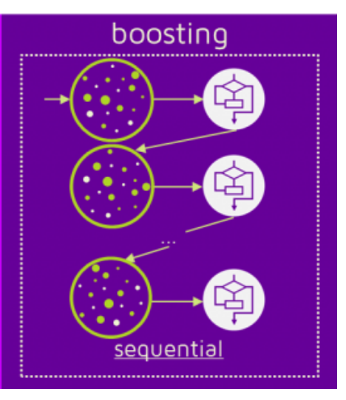
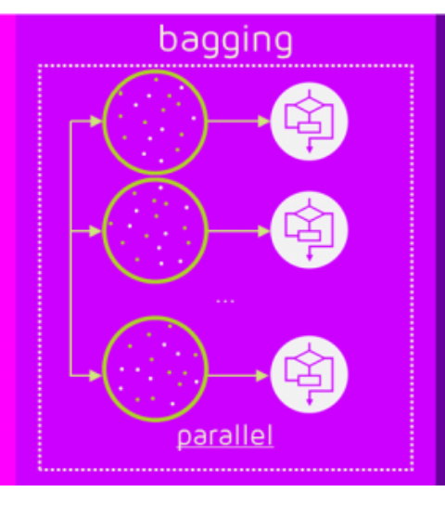
Decision Trees: Boosting vs. Bagging
Boosting and Bagging are two different approaches to generating classifiers for ensemble learning
For boosting algorithms, after a classifier is trained on the data, the weights of the observations it misclassified are increased
The next classifier is then trained on the observations with the weights adjusted based on the results of the prior classifier
XGBoost and Gradient Boosting are examples of Boosting
Random Forest is an example of bagging (Bootstrapping and Aggregating)
Source: quantdare

Slide 32
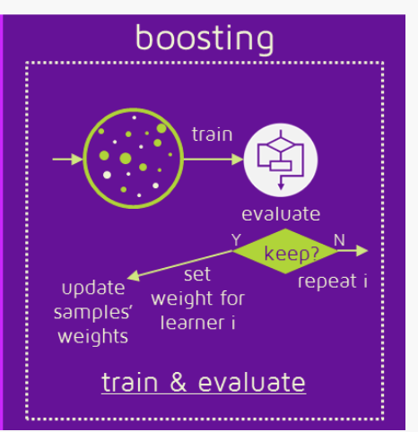
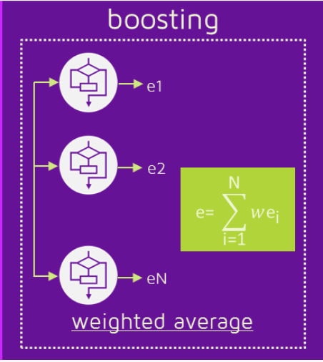
Boosting: Classification
Unlike Bagging which takes a simple average of its classifiers to make prediction, Boosting also generates classifier weights during the training stage which it uses to weight classifiers and make predictions
Source: quantdare

Slide 33
Gradient Boosting
There are different types of Boosting, (training multiple ”weak learners” sequentially to improve model predictions)
XGBoost uses Gradient Boosting but in the recent past other forms of Boosting such as AdaBoost (Adaptive Boosting) were popular
Gradient Boosting is a type of Boosting which uses gradient descent as its loss function
Rather than training the next classifier on a re-weighted set of observations as in AdaBoost, Gradient Descent takes the errors/residuals of the previous classifier and trains on that

Slide 34
What is XGBoost? (eXtreme Gradient Boosting)
“The name XGBoost, though, actually refers to the engineering goal to push the limit of computations resources for boosted tree algorithms. Which is the reason why many people use xgboost.”— Tianqi Chen
XGBoost is a library for the implementation of gradient boosted decision trees designed for speed and performance created by Tianqi Chen

Slide 35
Decision Trees: XGBoost vs. Random Forest
Gradient Boosting and Random Forest are both ensemble learning methods which use the outputs of many decision trees to make predictions
Gradient Boosting as a type of Boosting method, uses the errors made by previous tree to fit a new tree. Since the new predictor is fit to residuals from the previous tree, Gradient Boosting grows trees sequentially
Random Forest trains full decision trees on random samples of the data set. Using random samples and growing trees that are uncorrelated, Random Forest grows trees in parallel

